Slide 1
deSRA v2.0
Ryan Connor
Rob Guthridge
Kristin Valdez
Luli Zou

Slide 2
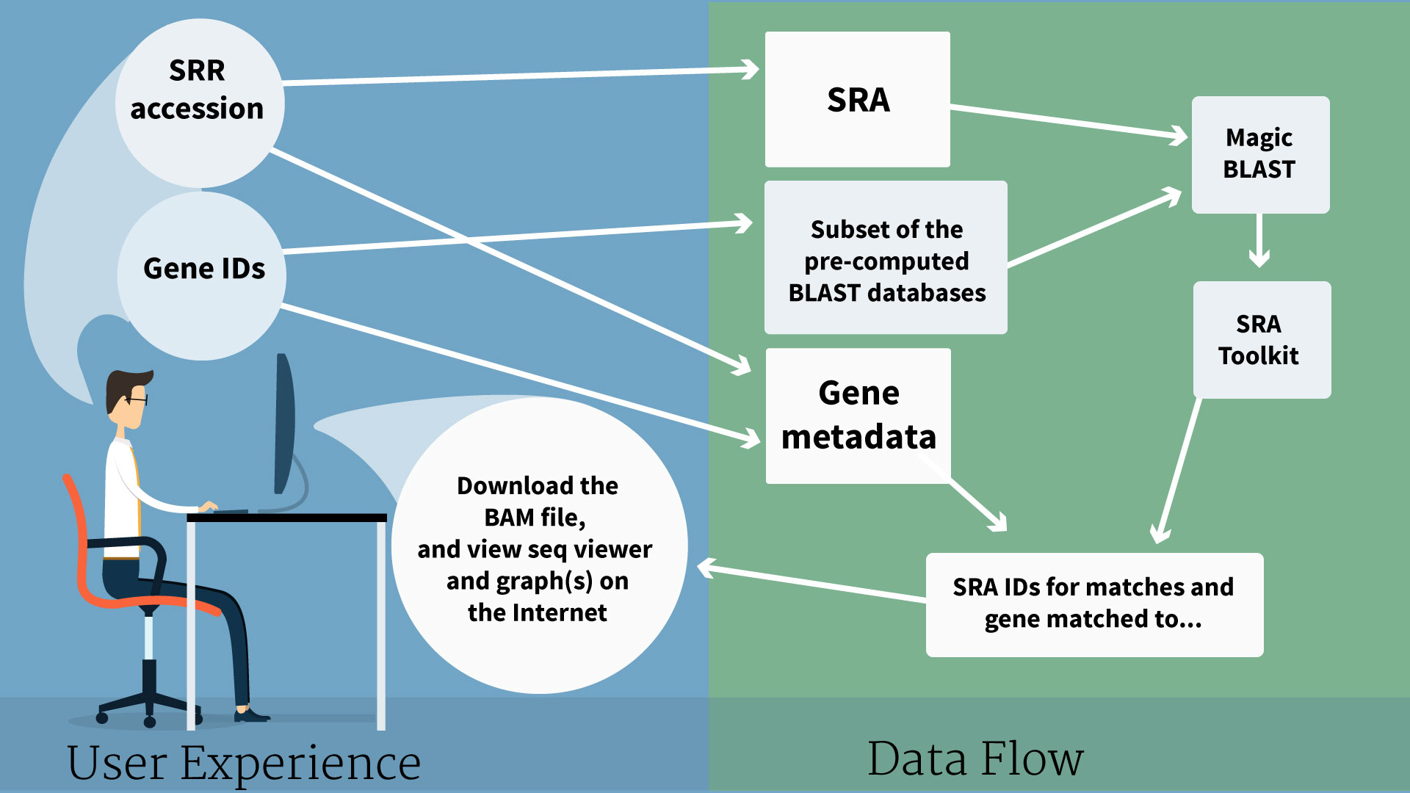
deSRA

Slide 3
deSRA
Input: SRR files, list of genes
1. Make BLAST DB from gene list
2. MagicBLAST SRRs again each gene
3. Visualize output

Slide 4
deSRA
Input: SRR files, list of genes
1. Make BLAST DB from gene list
2. MagicBLAST SRRs again each gene
3. Visualize output

Slide 5
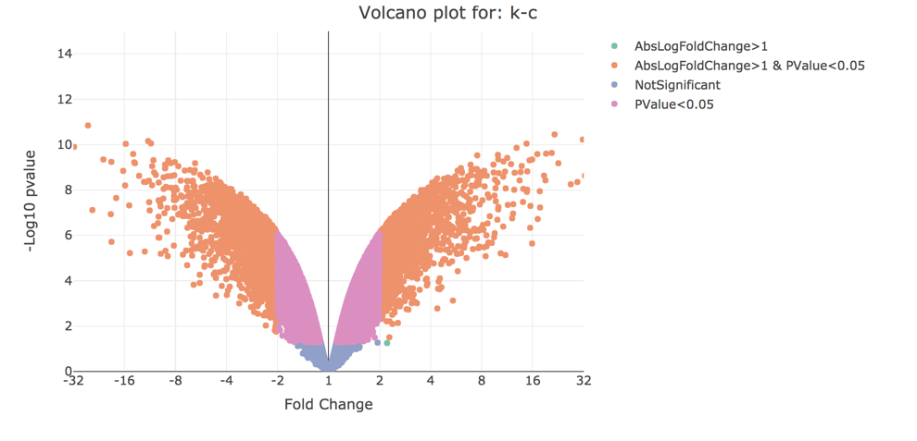
Micro Array App (CCBR-NCI)

Slide 6
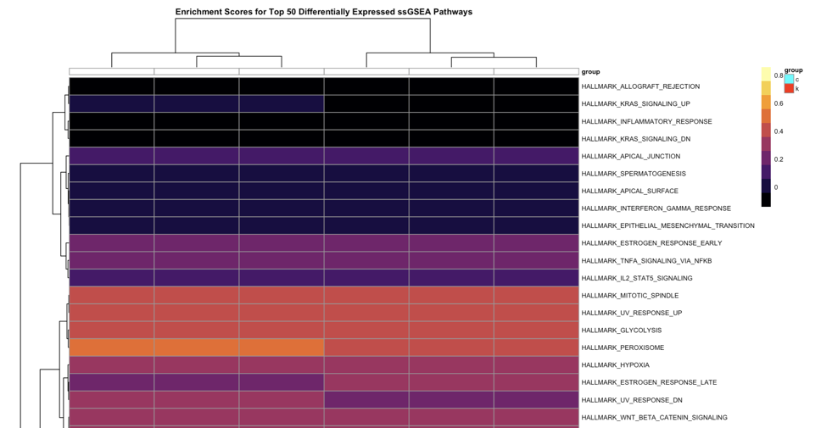
Micro Array App (CCBR-NCI)

Slide 7
Micro Array App (CCBR-NCI)
Input: *.CEL files (or counts for RNA-Seq)
1. Normalize
2. Annotate
3. Compute DEGs
4. Visualize

Slide 8
deSRA + Microarray App
deSRA Input: SRR list and gene list
Take deSRA TPM file as output
MAA Input: gene list and TPM files
MAA visualizations

